Slide 1
Pizza Sales Analytics Project
SQL Server views + Power BI dashboard · 2015 sales performance
Prepared by Eng: Hassan Wahba
Notes:
Overview of the Pizza Sales Analytics project: SQL Server views feeding an executive Power BI report.

Slide 2
2015 at a glance
Core KPIs from the pizza_sales dataset (12 fields)
$817.86K
$38.31
49,574
21,350
2.32
Total revenue
Avg order value
Pizzas sold
Total orders
Avg pizzas / order
Goal: turn row-level store logs into insight that reduces inventory overhead and matches staffing to demand.

Slide 3
How the pipeline works
From transactions to executive dashboard
SQL Server
Power BI import
Dashboard
17 decoupled views (KPIs, rankings, trends, shares) shield BI from raw row scans
Select the 17 views, validate types in Power Query, Close & Apply
Two pages: Home & Macro Sales, and Best/Worst Sellers
›
›

Slide 4
Demand peaks Thu–Sat and in summer
Total orders by weekday and by month
Friday is the busiest day (3,538 orders). July leads the year (1,935), followed by May and August.

Slide 5
Classic and Large lead sales
Share of revenue (%) by category and by size
Classic also sells the most pizzas (14,888). Large pizzas bring in 45.89% of revenue; XL and XXL are marginal.

Slide 6
Best and worst sellers
Top 5 vs bottom 5 pizzas by quantity sold
Top 5
Bottom 5
Thai Chicken is the top revenue pizza ($43.43K). Brie Carre is last on quantity, orders (480) and revenue ($11.6K).

Slide 7
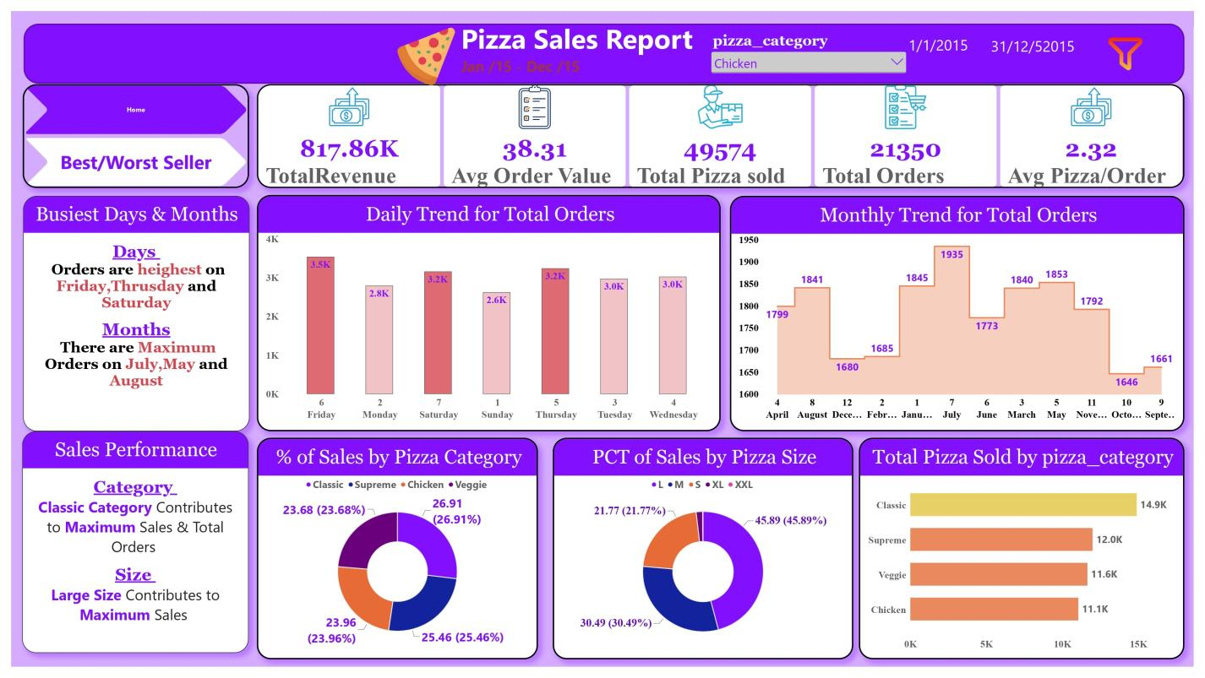
Dashboard page 1: Home & Macro Sales

Slide 8
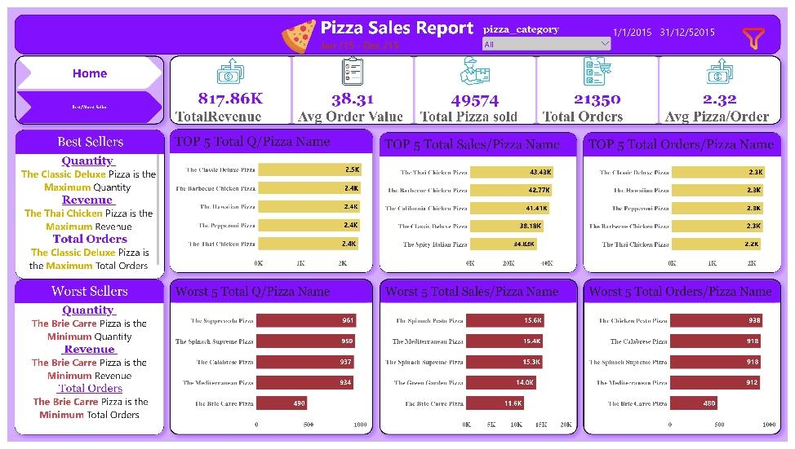
Dashboard page 2: Best & Worst Sellers

Slide 9
Key takeaways
Staff up for Thursday, Friday and Saturday; plan for the July, May and August peaks.
Classic is the strongest category; Large is the size that drives revenue.
Thai Chicken leads revenue, Classic Deluxe leads volume.
Brie Carre underperforms on every metric: a candidate for menu review.
github.com/enghassanwahba/Data_Analysis_HW_Pizza_Sales_SQL_PowerBI
Prepared by Eng: Hassan Wahba

